Slide 1
GMS6850 – Core Concepts in Bioinformatics Lecture 1, 2022 Jan 10 Intro to the faculty and the course Bioinformatics landscape Review of biological molecules
Faculty: Steve Rozen, Sujoy Ghosh, Enrico Petretto, Lisa Tucker-Kellogg
With guest lectures from Abner Lim, Weng Khong LIM, Owen Rackham, Gavin Smith, Federico Torta, Jacques Behmoaras

Slide 2
Outline
Faculty introductions
“What is Bioinformatics?” and aims scope of this course
Next generation sequencing and bioinformatics
Review of biological molecules
Summary

Slide 3
My story
Undergrad degree in dance
Got work, but concluded it wasn’t viable (and not very interesting, and I wasn’t very talented)
Got a masters in computer science
Worked on Wall Street for 2 years
Got a PhD in computer science (the dumb way, part time)
Was not willing to relocate for a faculty job in computer science for family reasons, so went to work for Eric Lander at a “genome center”

Slide 4
My story
Helped sequence the human and mouse genomes (small role in huge international effort)
Wrote the Primer3 software and web interface (with Helen Skaletsky), cited by 20,000 papers
Went to the lab of David Page and did a mix of lab work and bioinformatics for 8 years
High profile genetics publications (Nature, Nature Genetics)
Went to Duke-NUS in 2008, found great collaborators in cancer genomics (Patrick Tan, Bin Teh)
Multiple high impact papers (AA, gastric cancer, bile duct cancer, mutational signatures)

Slide 5
Outline
Faculty introductions
“What is Bioinformatics?” and aims scope of this course
Next generation sequencing and bioinformatics
Review of biological molecules
Summary

Slide 6
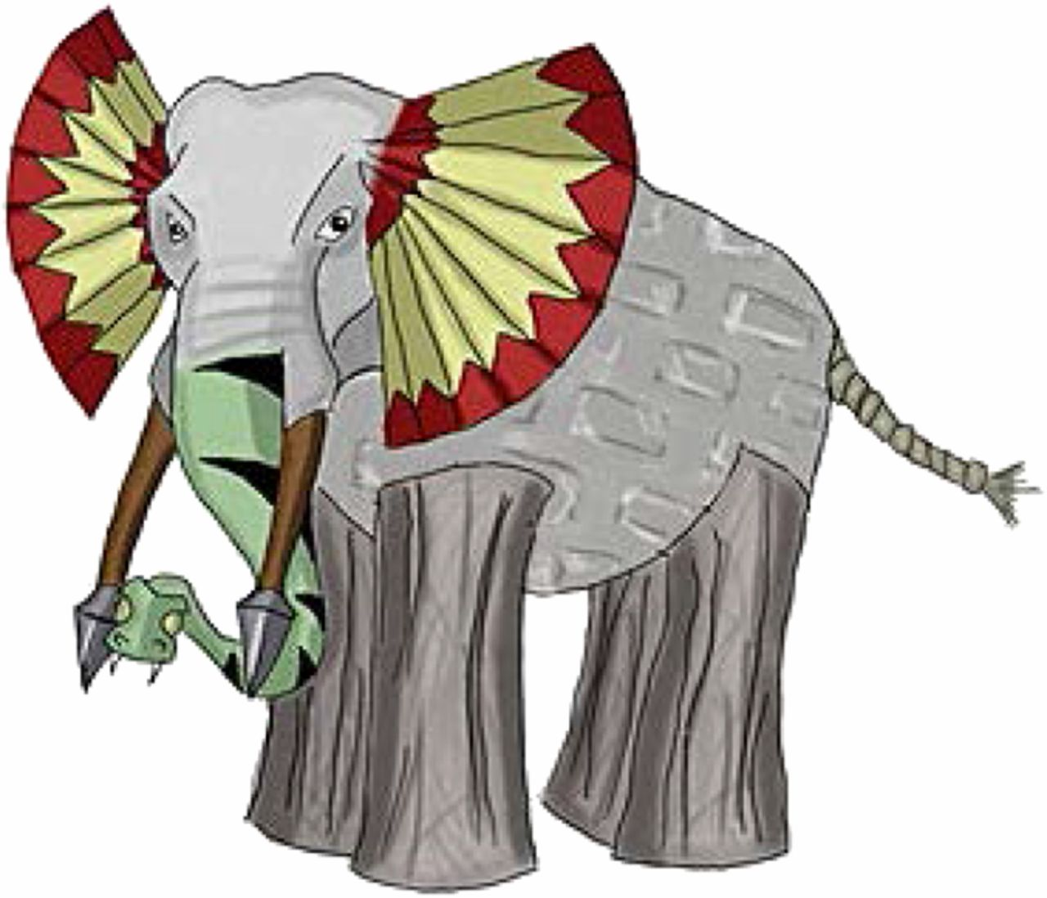
What is bioinformatics?

Slide 7
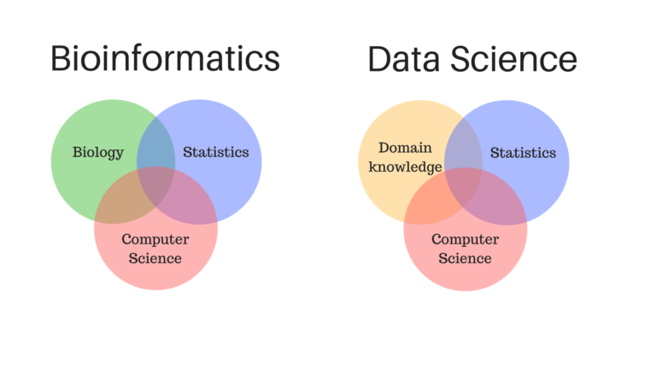
What is bioinformatics?
?

Slide 8
What is bioinformatics?
Looking at a lot of data to:
Show you ads that you will click on
Detect credit card fraud
Assemble a winning baseball team (Sabermetrics / Moneyball)
Predict result of the US November 2018 election
?
http://omgenomics.com/what-is-bioinformatics/

Slide 9
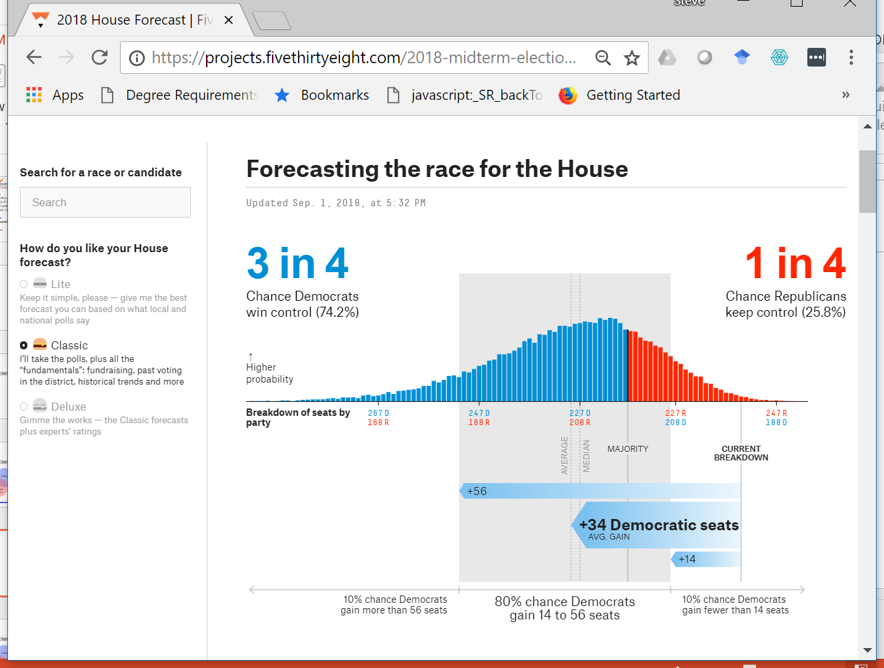
Forecasting the election of the US House of Representatives in November, 2018
FiveThirtyEight
https://fivethirtyeight.com

Slide 10
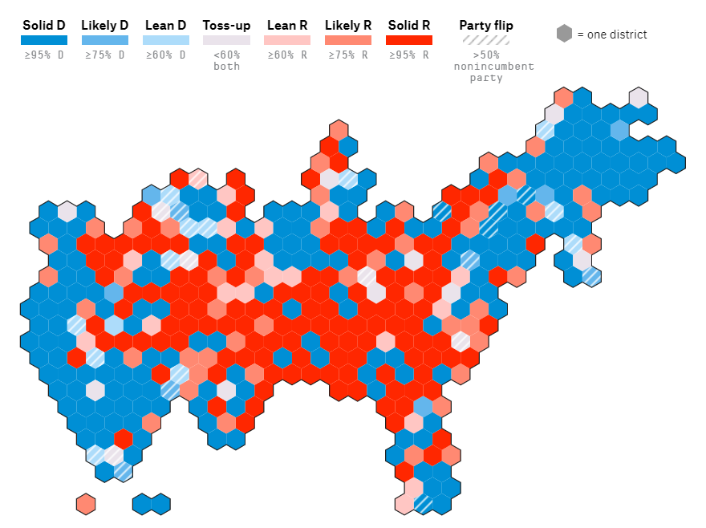
All house races

Slide 11
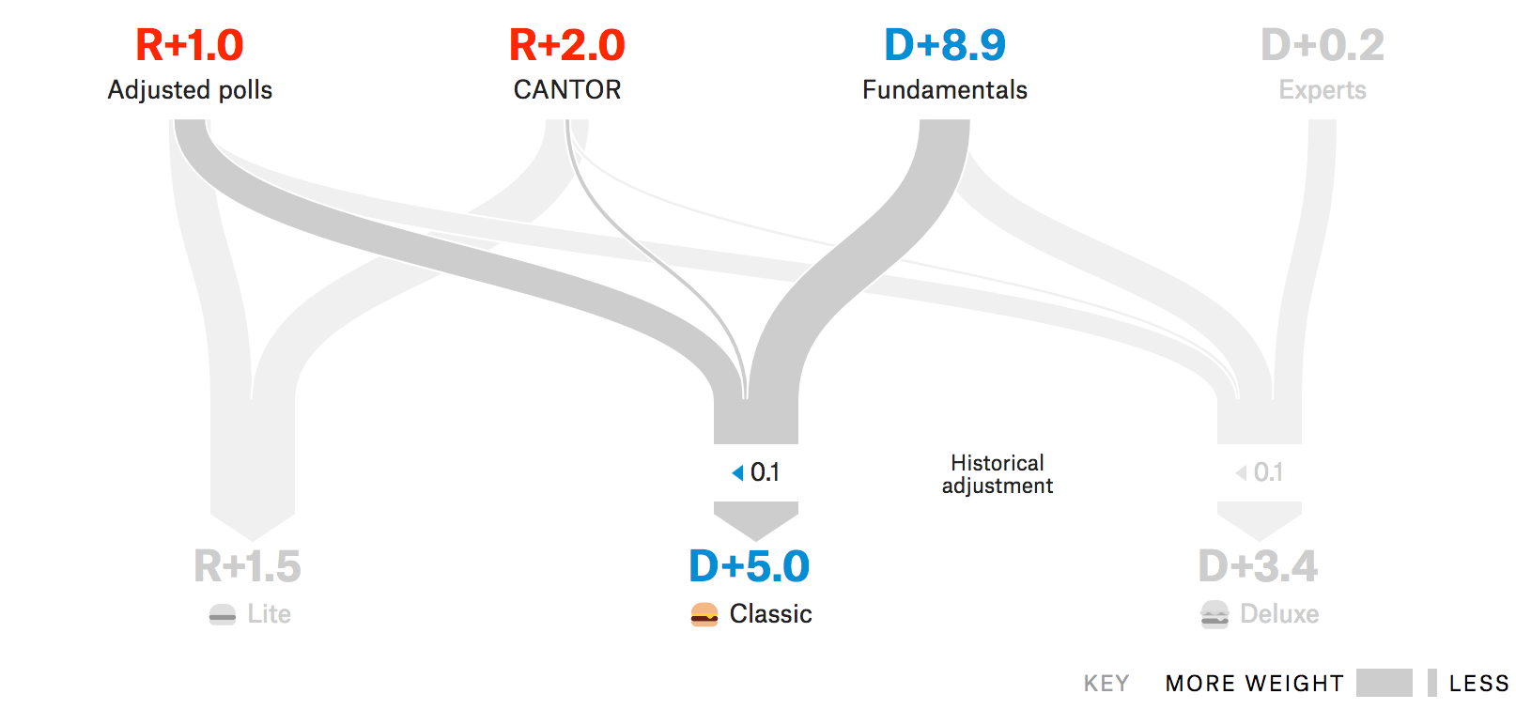
Models for 1 house race
Imputation of polling results
Fundamentals:
$s, district’s voting history

Slide 12
Forecast pretty good:
FiveThirtyEight
https://fivethirtyeight.com
Actual gain, 41 seats
235 D
199 R

Slide 13
What is bioinformatics?
Statistics with a really large amount of data
Overlaps with
Statistical machine learning
Artificial intelligence
?
http://omgenomics.com/what-is-bioinformatics/

Slide 14
What is bioinformatics?
http://omgenomics.com/what-is-bioinformatics/

Slide 15
What is bioinformatics?
http://omgenomics.com/what-is-bioinformatics/

Slide 16
What is bioinformatics?
Specialization within bioinformatics driven by biological focus
Focus of the course will be on “genome informatics” and network biology with some human genetics (e.g. GWAS – genome wide association studies)
Some other, related areas:
“structural bioinformatics” https://en.wikipedia.org/wiki/Structural_bioinformatics Alphafold (artificial intelligence to predict protein structure from protein sequence): https://www.youtube.com/watch?v=gg7WjuFs8F4, https://www.youtube.com/watch?v=RmYaM-_7YjY
Population and evolutionary genetics
Biological image analysis (from microscopy to medical imaging)
“Medical informatics” (dealing with health records – not bioinformatics at all (?))
http://omgenomics.com/what-is-bioinformatics/

Slide 17
Being a bioinformatician
Expertise in one area, competence in others
Sometimes unusual career paths

Slide 18
Being a bioinformatician
Expertise in one area, competence in others
Software engineering and algorithms, for example Primer3
Sometimes unusual career paths

Slide 19
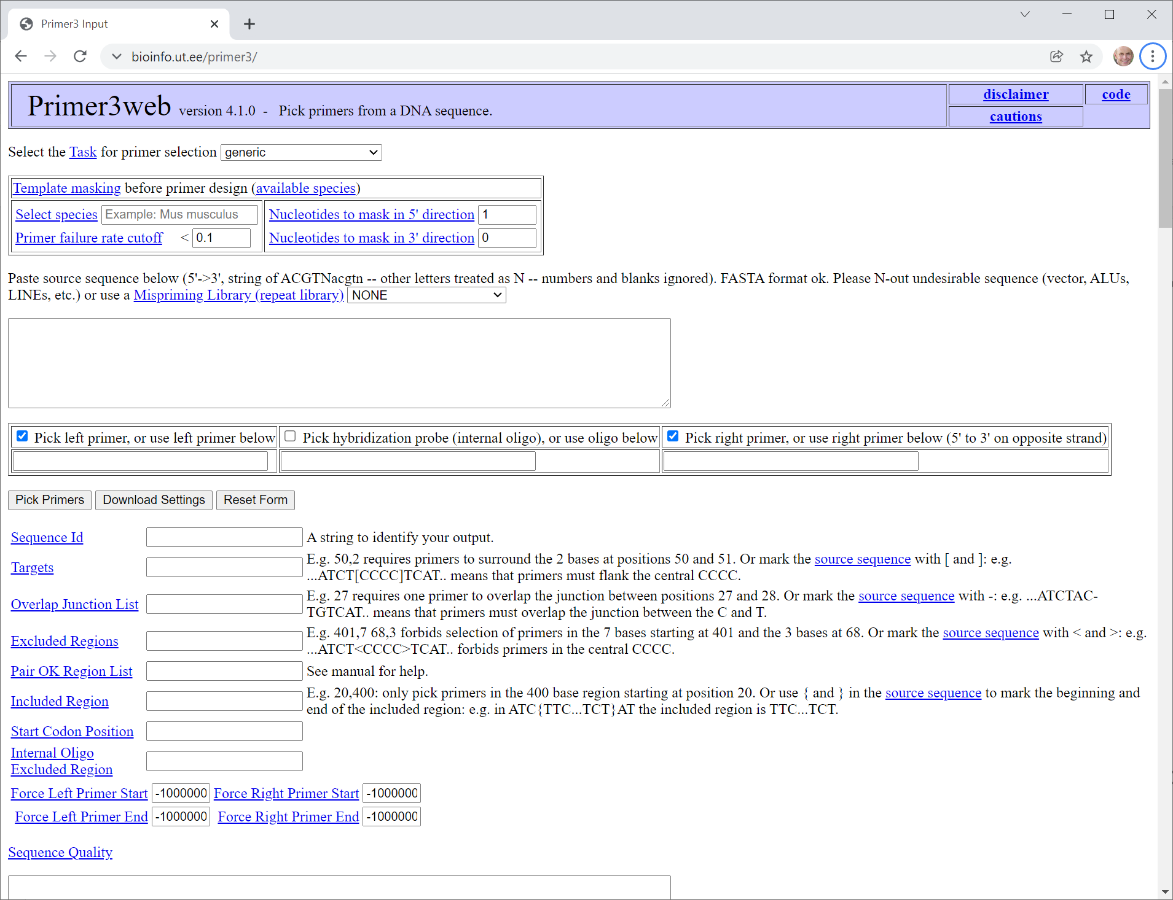
https://bioinfo.ut.ee/primer3/

Slide 20
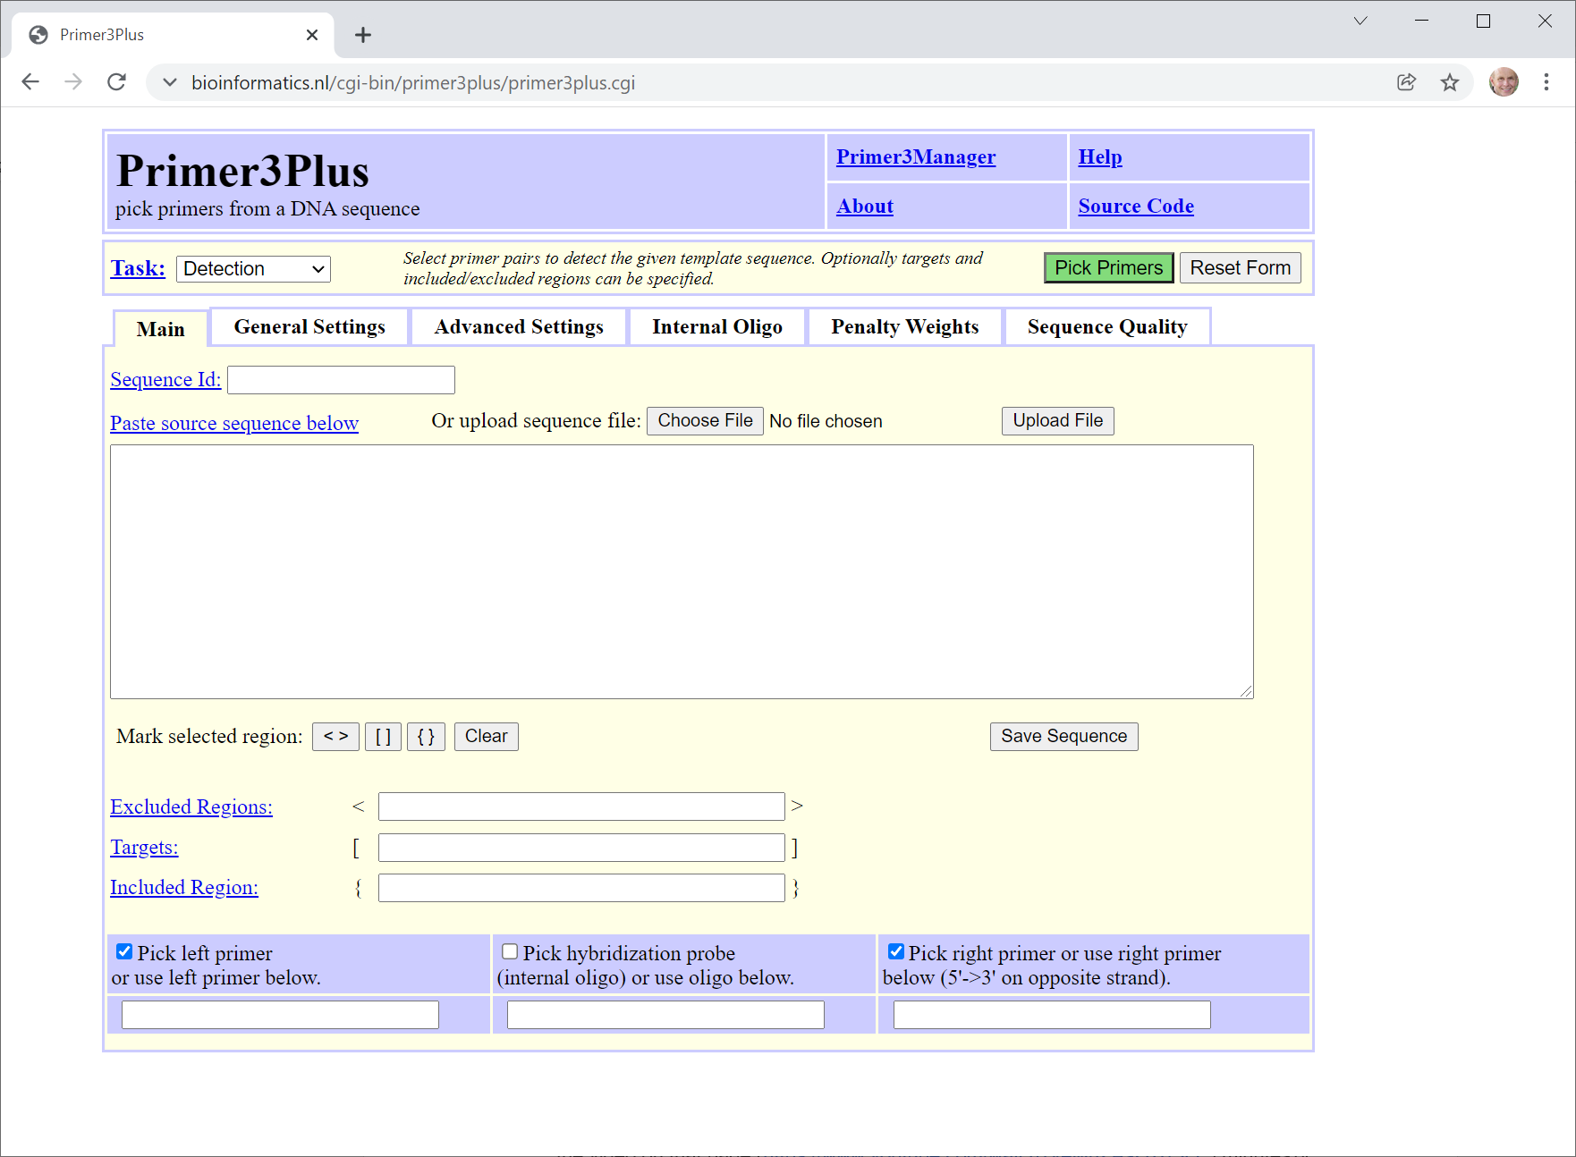
https://www.bioinformatics.nl/cgi-bin/primer3plus/primer3plus.cgi

Slide 21
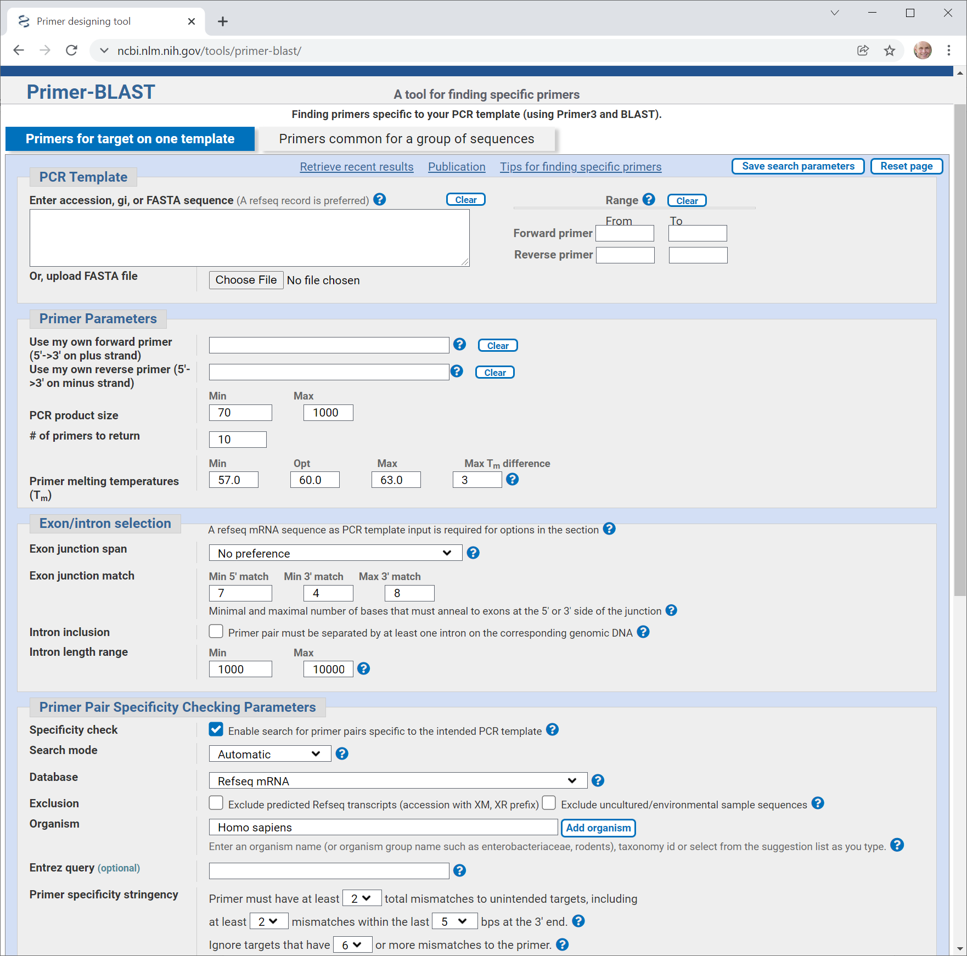
https://www.ncbi.nlm.nih.gov/tools/primer-blast/

Slide 22
Being a bioinformatician
Expertise in one area, competence in others
Naturally occurring aristolochic acid causes many cases of liver cancer
Sometimes unusual career paths

Slide 23
Bioinformatics depends on having a lot of data
This started to happen in the late 1990s
At that time it was based on technologies we will not discuss today (microarrays, etc)

Slide 24
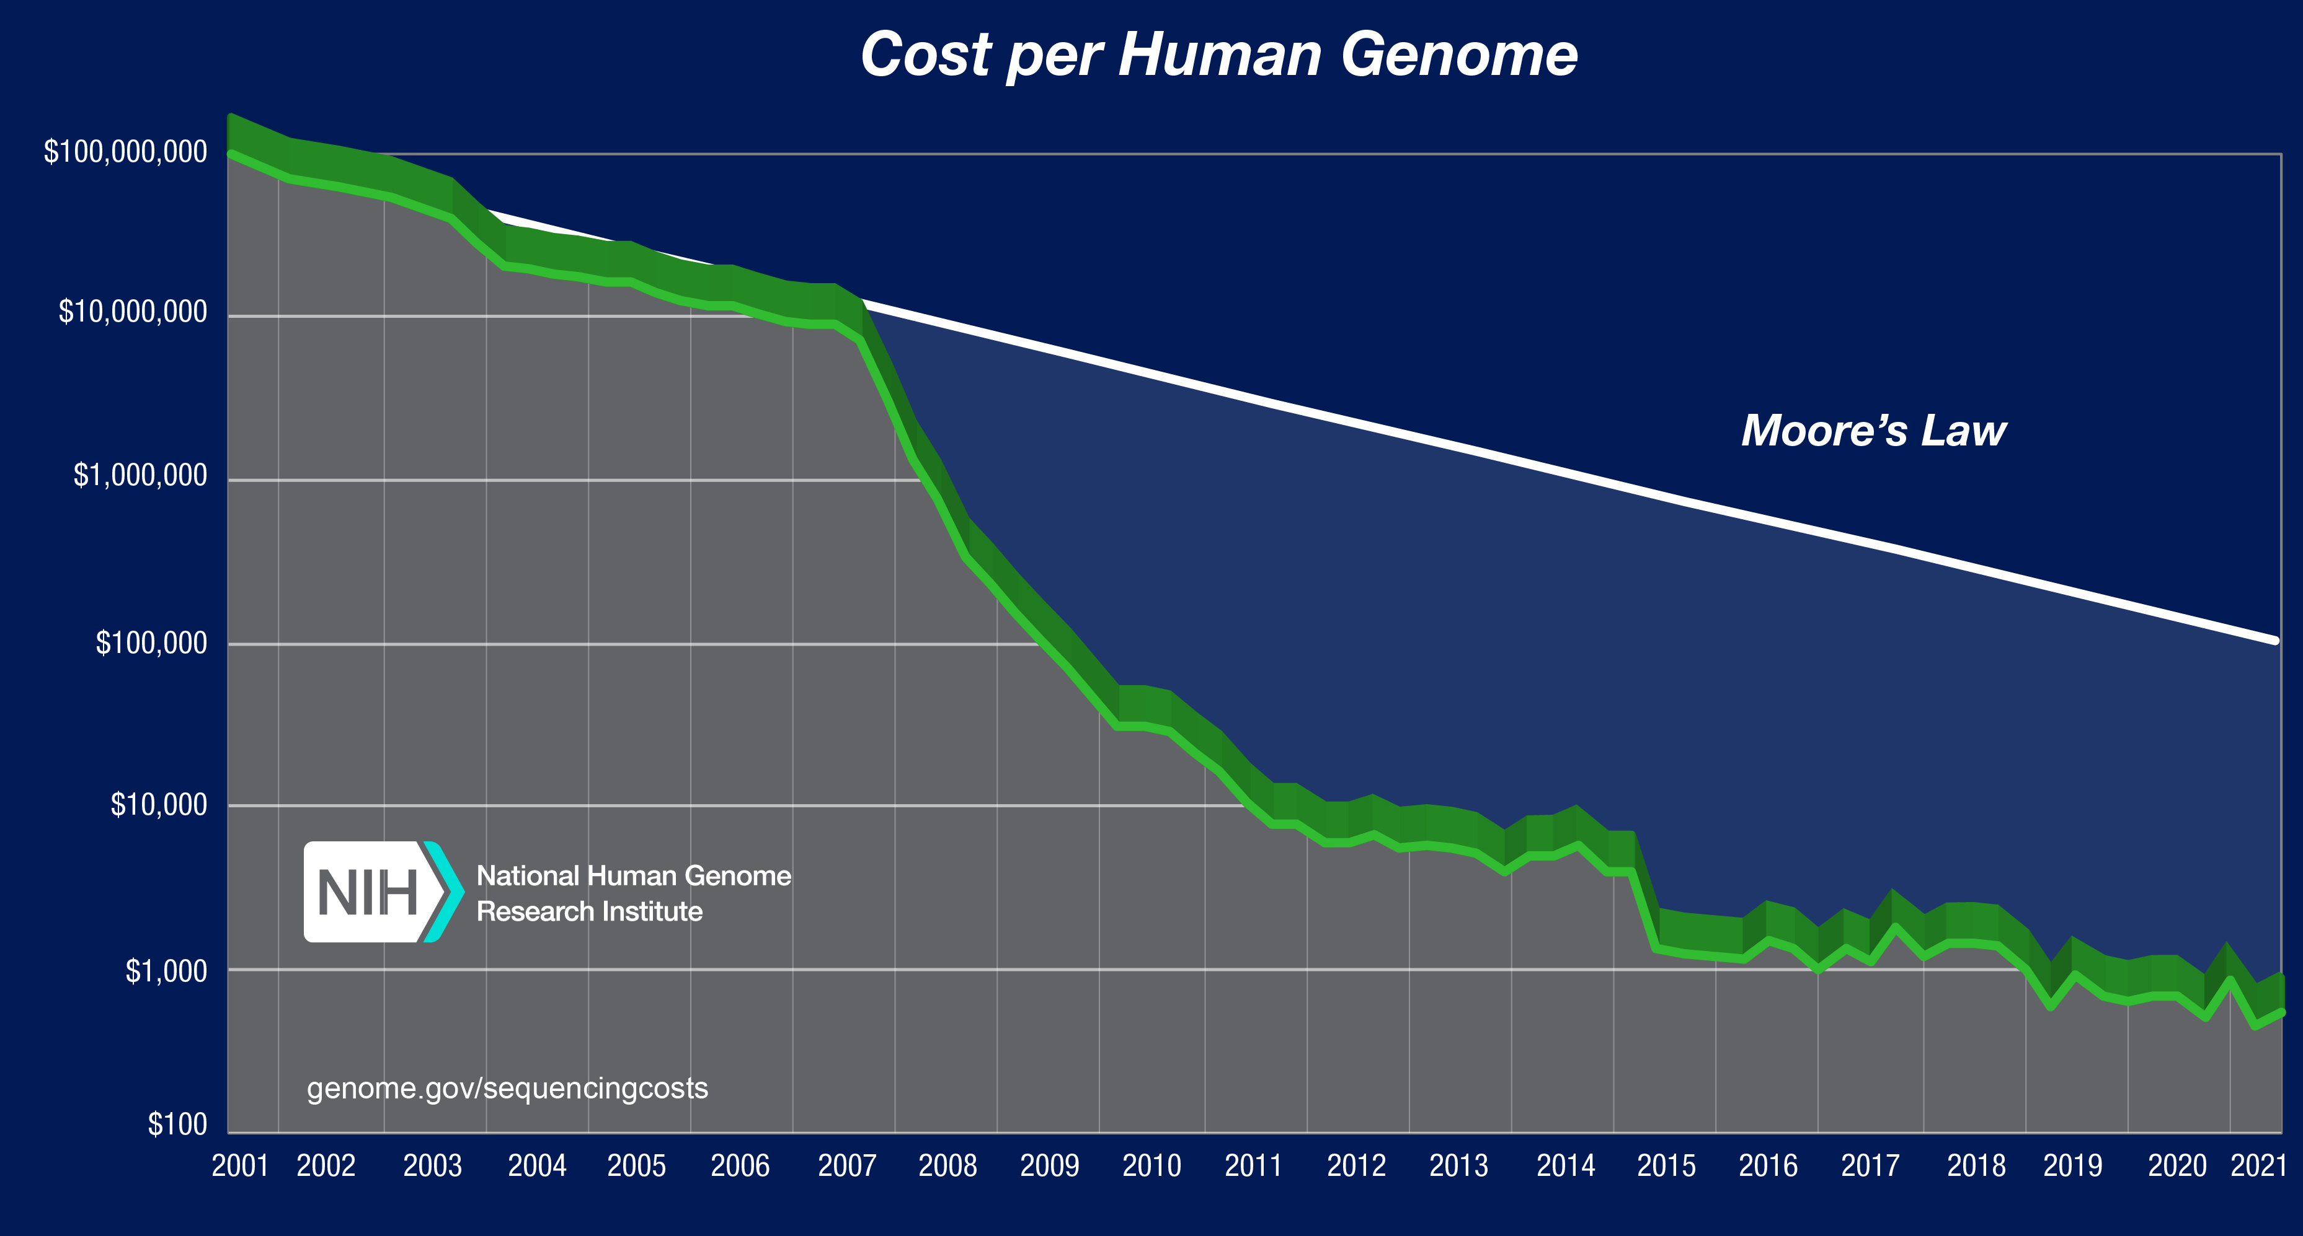
Data generation really took off in 2007
1 Human genome:
$10 million
In 2007
Moore’s Law (cost of computing power)
10,000 X
drop in price
Cost to sequence
1 human genome (US$)
Note log scale
US$ 1,000，today
Year
https://www.genome.gov/about-genomics/fact-sheets/DNA-Sequencing-Costs-Data

Slide 25
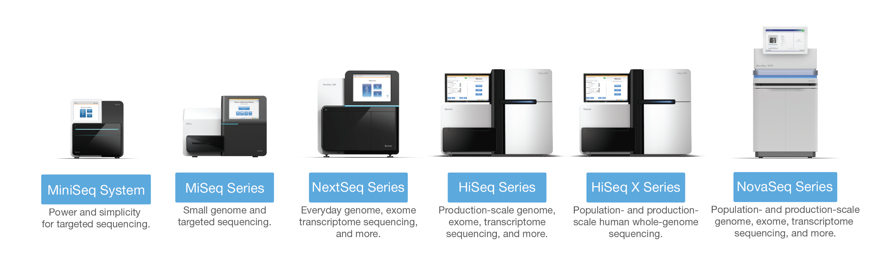
Dominant technology
https://www.illumina.com/content/dam/illumina-marketing/documents/products/illumina_sequencing_introduction.pdf

Slide 26
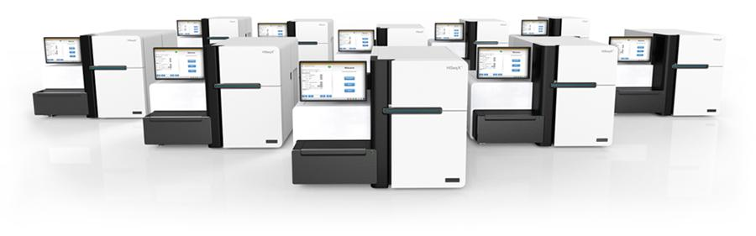
Need for computing infrastructure: $10 million worth of sequencers
Notes:
http://glennklockwood.blogspot.sg/2014/01/the-1000-genome-computational.html
18,000 genomes a year (Source: http://blog.illumina.com/blog/illumina/2014/01/14/the-power-and-promise-of-population-scale-genomics)
100 Gbytes * 18,000 = 1.8 petabytes
1 node 3 weeks, so, 1 node can do 17 genomes per year; 18,000 / 17 = 1,000 nodes = 16,000 cores!!!!!
Based on glennlockwood, we would need 1,000 cores (62 nodes) running full time just for the alignments, 30K per node, = 30,000 * 62 = ~ 2 million just for the alignments

Slide 27
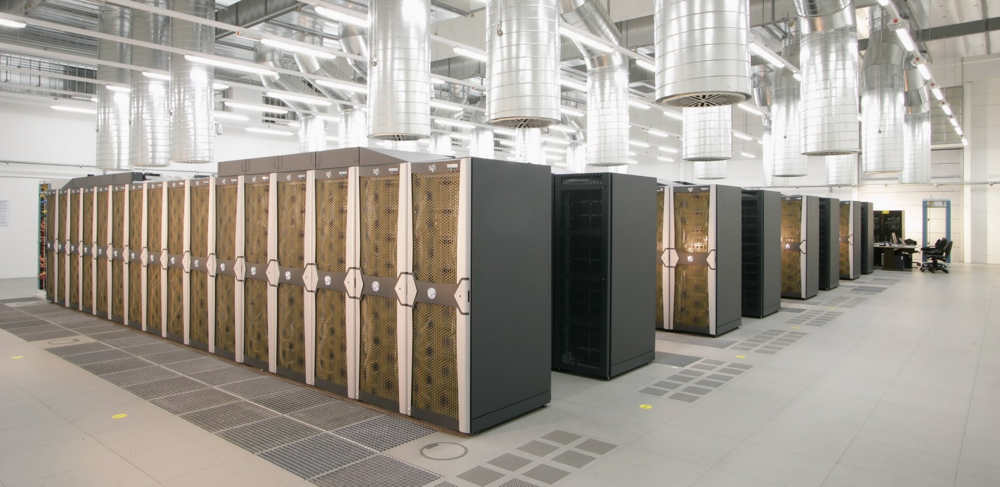
$> 10 million worth of computing equipment to analyze data
Need computing infrastructure

Slide 28
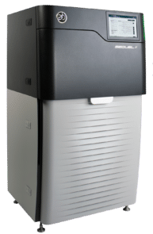
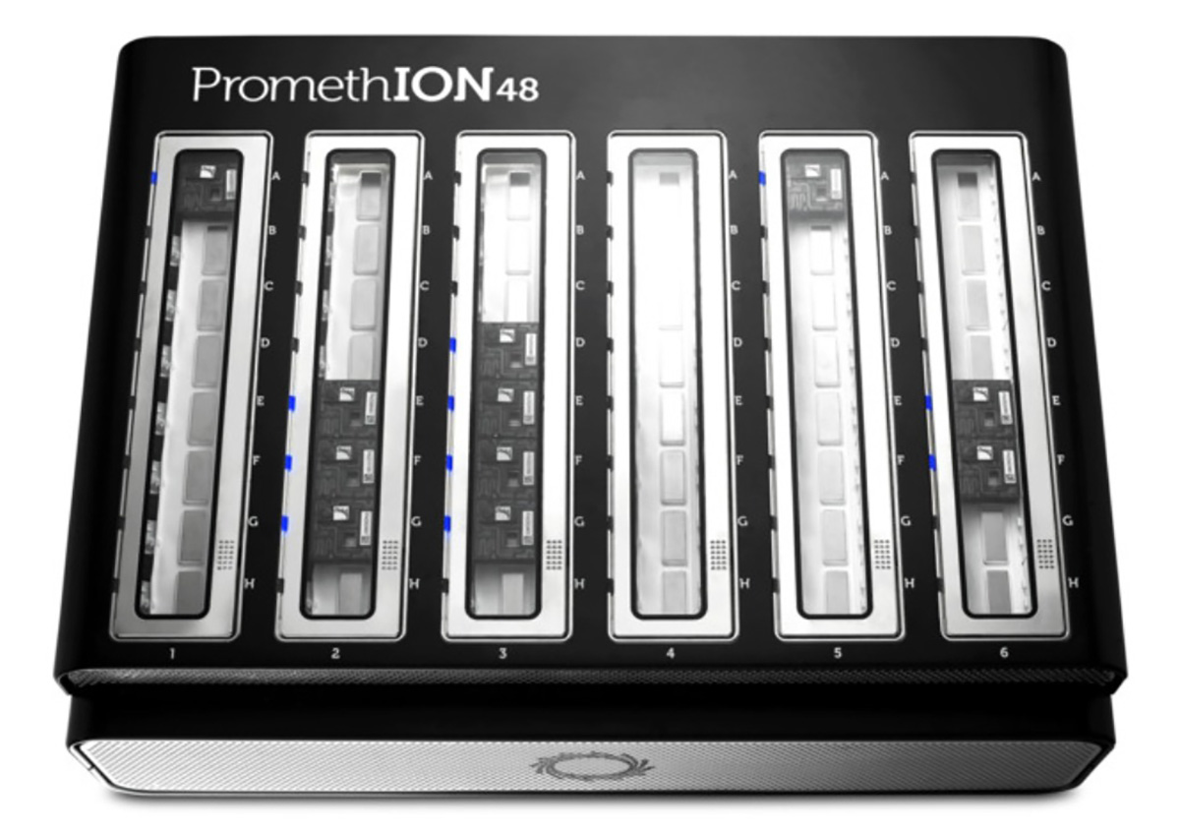
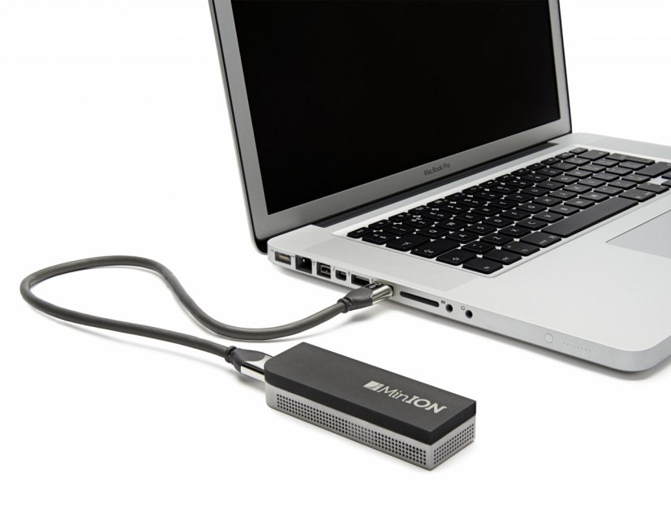
Other sequencing technology, long reads
https://nanoporetech.com/
https://www.pacb.com/

Slide 29
Sequencing is leading the genomics revolution Sequencing drives perhaps 80% of bioinformatics research Why is sequencing so important?

Slide 30
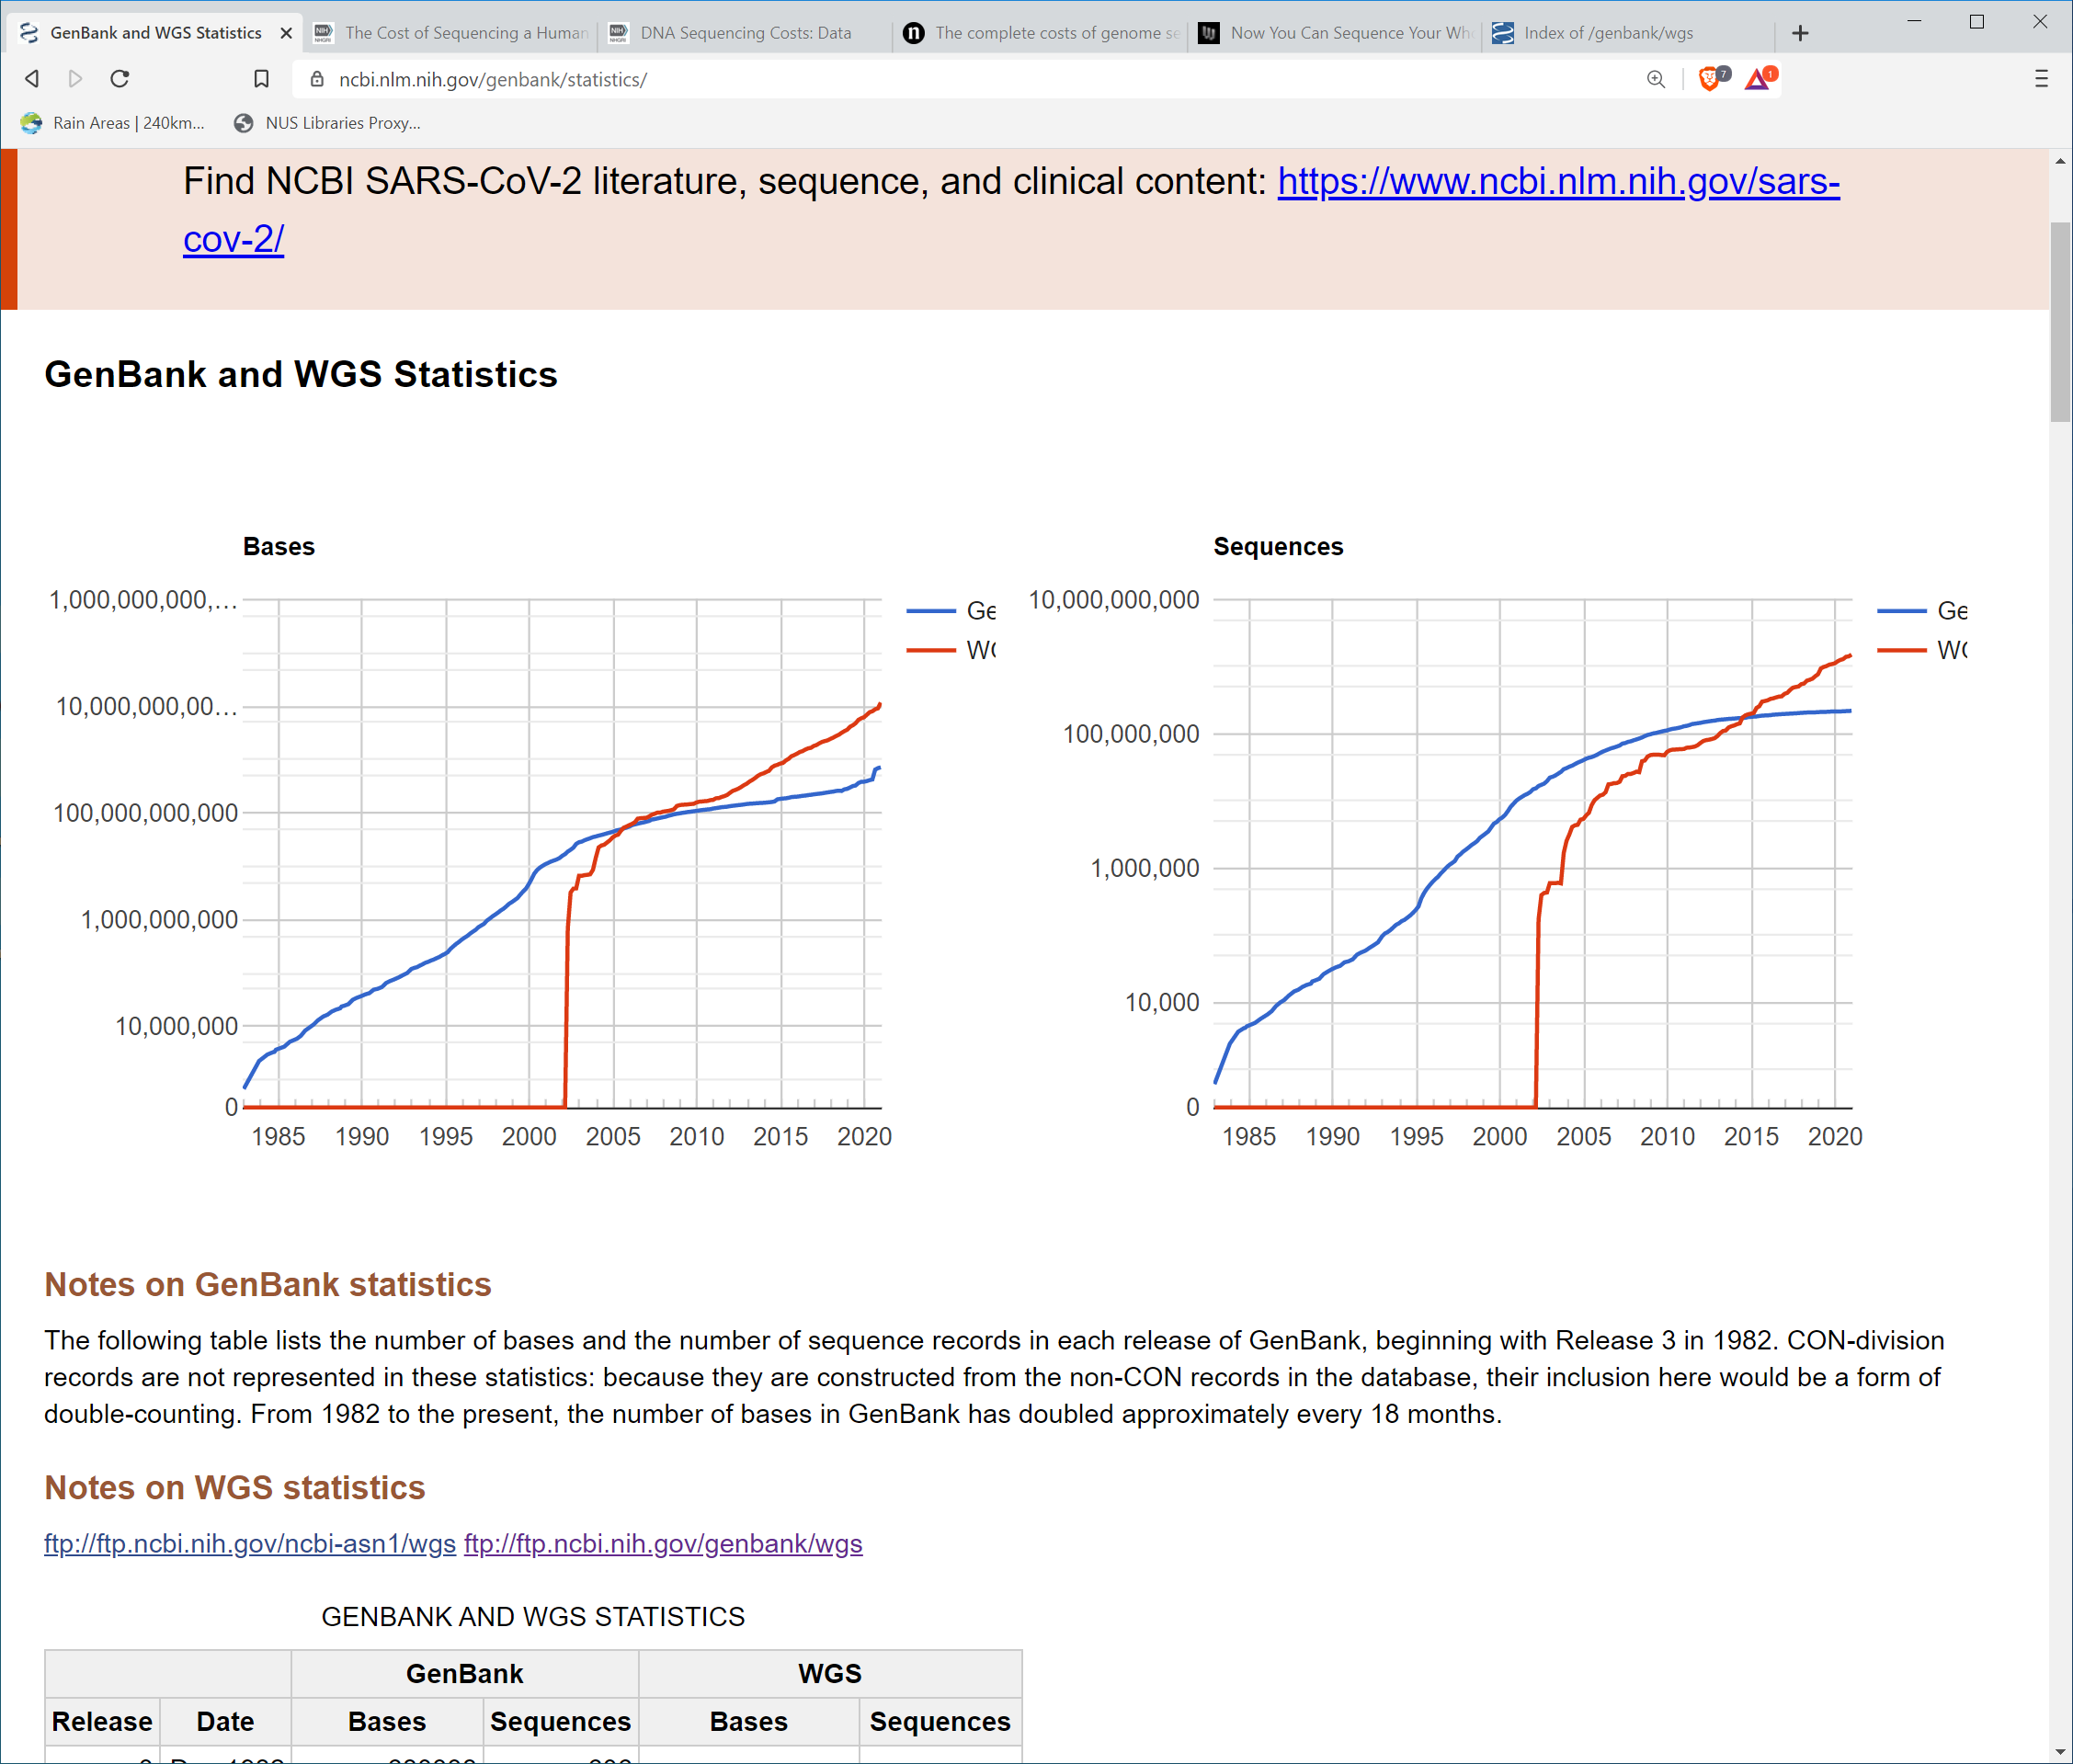
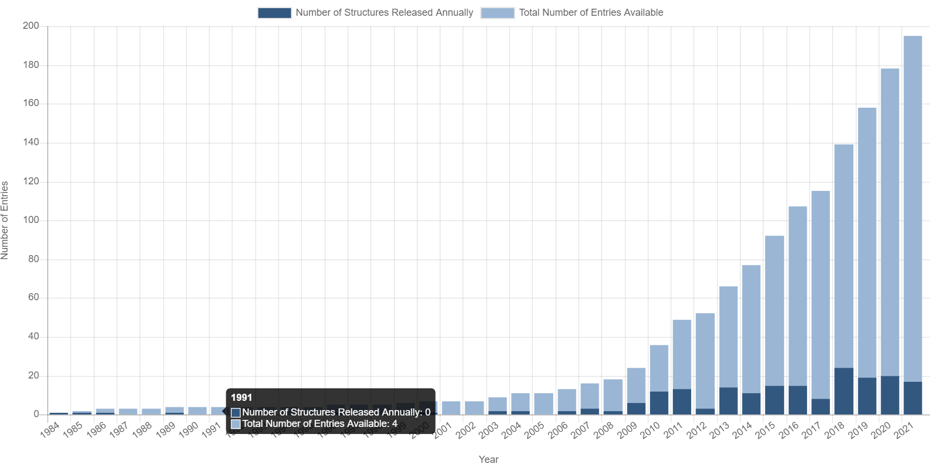
Contrast nucleic acid sequences with protein structures
GenBank sequence database:
13 trillion bases, 1.6 billion sequence entries; doubling ~every 18 months
The number of protein structures in Protein DataBank (PDB, https://www.wwpdb.org/)
10¹³
10¹¹
10⁹
By Dcbmariano - Own work, CC BY-SA 4.0, https://commons.wikimedia.org/w/index.php?curid=87488007
https://www.ncbi.nlm.nih.gov/genbank/statistics/

Slide 31
Outline
Faculty introductions
“What is Bioinformatics?” and aims scope of this course
Next generation sequencing and bioinformatics
Review of biological molecules
Summary

Slide 32
DNA sequencing in context
Your body contains roughly 30 trillion human cells
Plus >100 trillion (mostly harmless) bacterial and other microbe cells
Each cell contains two copies of your genome¹
Each copy of the genome is, abstractly, a string of 3 billion DNA letters: A, C, G, T
2% of this is “genes”
Sometimes there are “spelling errors” in genes (“gene variants”)
Next, two examples of in-born spelling errors…
¹ An oversimplification – some types of cells do not have any copies of the genome and sometimes cells have multiple copies.

Slide 33
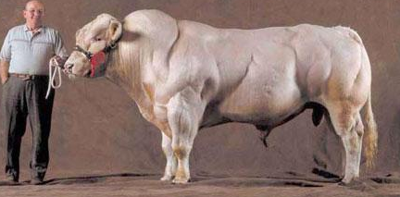
Spelling error that inactivates a gene that suppresses muscle growth (double negative is a positive)

Slide 34
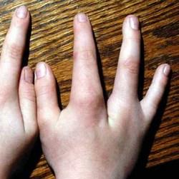
Cleft hand
Sometimes caused by genetic variants in the SEM1 gene (also known as SHFM1)
http://omim.org/clinicalSynopsis/119100

Slide 35
DNA mutations and cancer
First, some vocabulary
“Oncogenic mutations” – mutations that directly cause cancer
This can be either because the oncogenic mutation…
turns OFF a gene that keeps cells from becoming cancer cells
…or…
turns ON a gene that encourages the cell to become a cancer cell

Slide 36
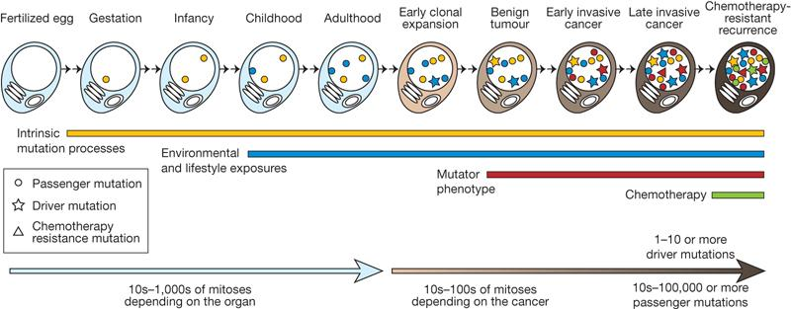

Cell divisions from the fertilized egg to a
single cell within a cancer ….
Somatic mutations are acquired by the cells over time
Cell nucleus
MR Stratton et al. Nature 458, 719-724 (2009) doi:10.1038/nature07943

Slide 37
Cell divisions from the fertilized egg to a
single cell within a cancer ….
Somatic mutations are acquired by the cells over time
Cell nucleus
Harmless mutations in the genome
MR Stratton et al. Nature 458, 719-724 (2009) doi:10.1038/nature07943

Slide 38
Cell divisions from the fertilized egg to a
single cell within a cancer ….
Somatic mutations are acquired by the cells over time
Cell nucleus
Harmless mutations in the genome
Oncogenic
mutations
and harmless
“passenger”
mutations
MR Stratton et al. Nature 458, 719-724 (2009) doi:10.1038/nature07943

Slide 39
Cell divisions from the fertilized egg to a
single cell within a cancer ….
Somatic mutations are acquired by the cells over time
Cell nucleus
Harmless mutations in the genome
Oncogenic
mutations
and harmless
“passenger”
mutations
Multiple
oncogenic
mutations
and harmless passenger mutations
MR Stratton et al. Nature 458, 719-724 (2009) doi:10.1038/nature07943

Slide 40
Cell divisions from the fertilized egg to a
single cell within a cancer ….
Somatic mutations are acquired by the cells over time
Cell nucleus
Harmless mutations in the genome
Oncogenic
mutations
and harmless
“passenger”
mutations
Multiple
oncogenic
mutations
and harmless passenger mutations
MR Stratton et al. Nature 458, 719-724 (2009) doi:10.1038/nature07943

Slide 41
We Identify cancer specific somatic mutations by large-scale sequencing (NGS)
…ACGTCCTAGTCAAAATCGAGCC…
…ACGTCCTAGTCTAAATCGAGCC…

Slide 42
We Identify cancer specific somatic mutations by large-scale sequencing (NGS)
…ACGTCCTAGTCAAAATCGAGCC…
…ACGTCCTAGTCTAAATCGAGCC…
Somatic mutation from A > T
(in a CAA trinucleotide context, so CAA > CTA)

Slide 43
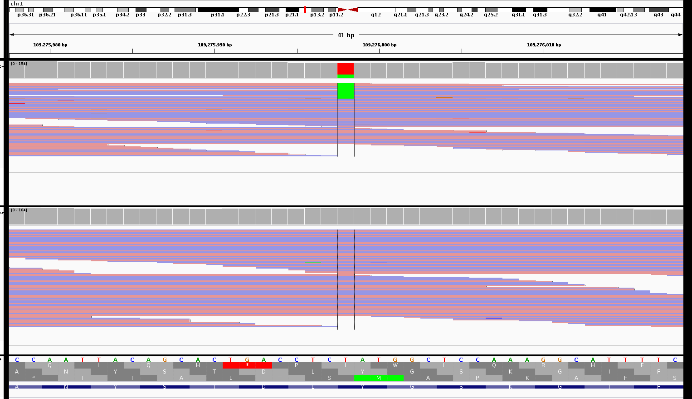
What the data actually look like
Shorts lengths of DNA read by sequencer (150 DNA letters long)
Tumour
A to T mutation in the tumour sample
Normal

Slide 44
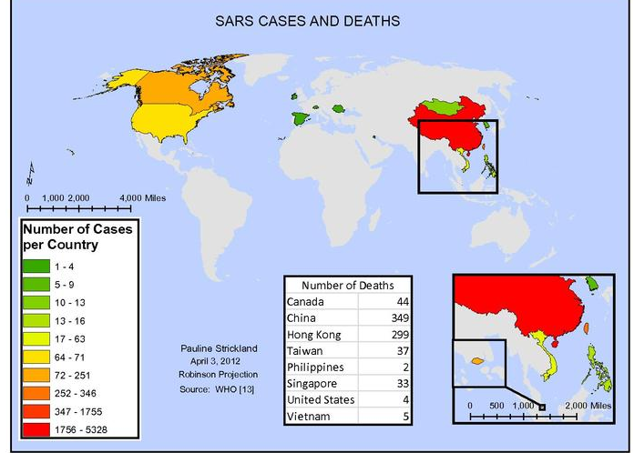
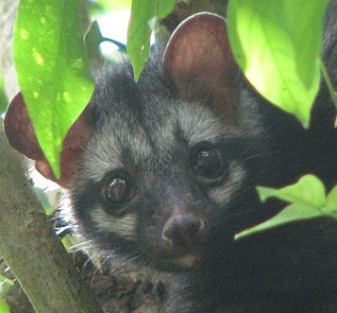
Pathogen discovery and evolution
SARS Cases and Deaths
https://en.wikipedia.org/wiki/Asian_palm_civet#/media/File:Asian_Palm_Civet_Over_A_Tree.jpg
https://en.wikipedia.org/wiki/File:Sars_Cases_and_Deaths.pdf

Slide 45
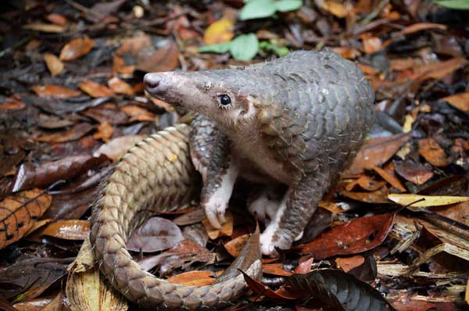
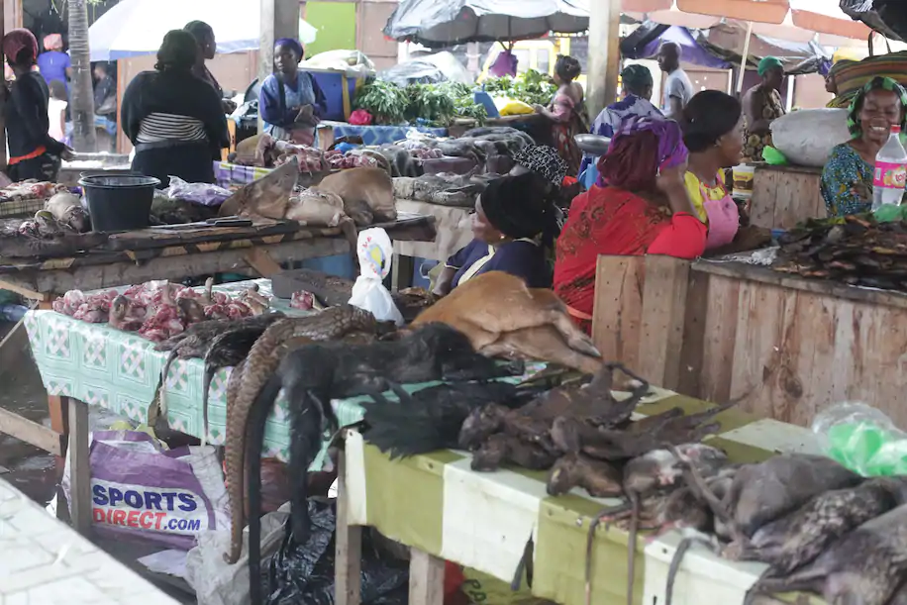
https://www.washingtonpost.com/science/2020/04/03/coronavirus-wildlife-environment/
A market where pangolins and other exotic animals are sold in Libreville, Gabon. (Steeve Jordan/AFP/Getty Images)
https://www.theborneopost.com/2013/03/31/protected-wildlife-on-the-menu/

Slide 46
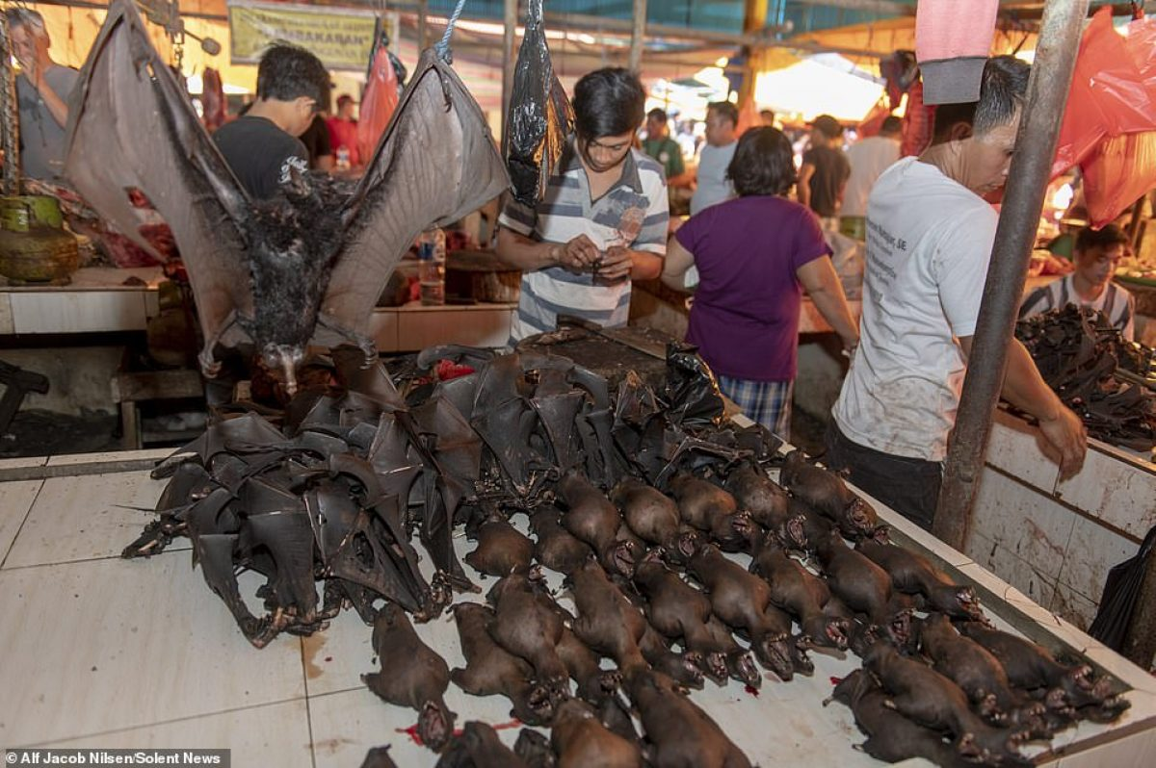

Slide 47
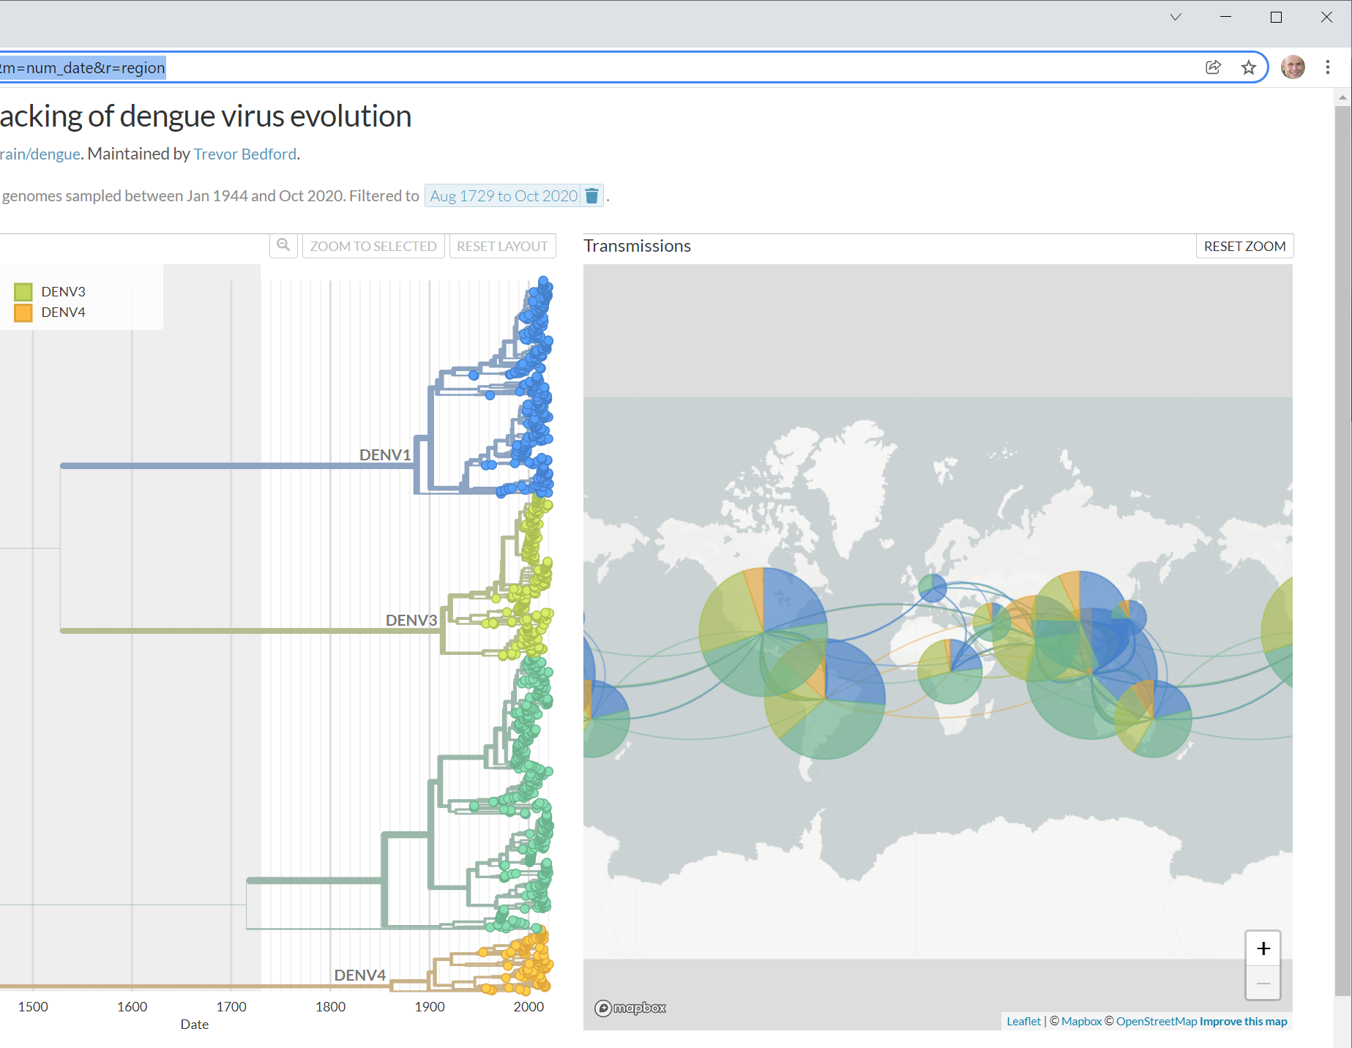
Dengue virus phylogeny
https://nextstrain.org/dengue/all?dmin=1729-08-31&m=num_date&r=region

Slide 48
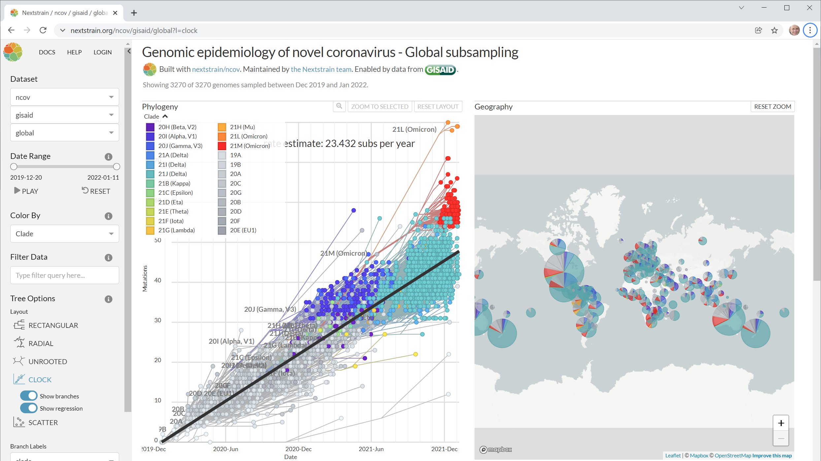
Novel coronavirus phylogeny
https://nextstrain.org/ncov/global

Slide 49
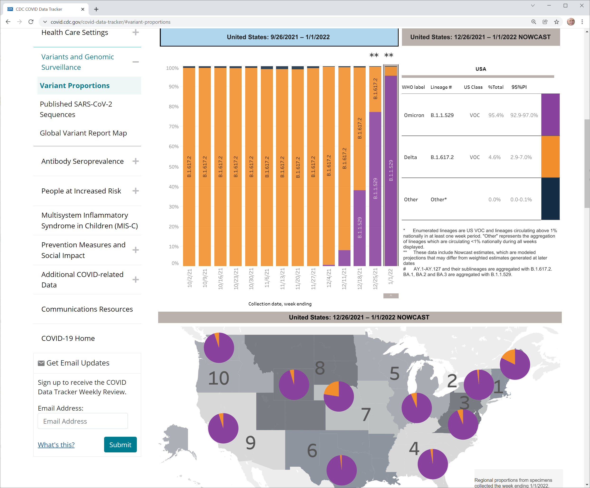
Simplified and more up to date
https://covid.cdc.gov/covid-data-tracker/#variant-proportions

Slide 50
Summary of many applications of genome sequencing
Human variation / human genetics
Infectious diseases
Cancer genetics
Plant and animal breeding for agriculture
Sequencing new genomes
Metagenomics --- sequencing bacteria and other microorganisms in
Our bodies
Anywhere else on earth (soil, deep sea thermal vents, under ice caps …)

Slide 51
That was genome sequencing But there’s more….

Slide 52
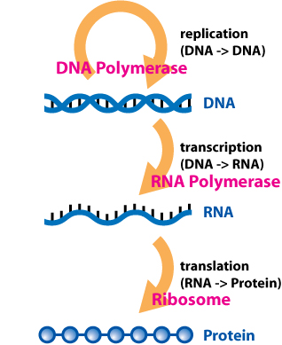
“Central Dogma”
RNA-seq:
Sequence the RNA in a tissue to get a picture of which genes are active (actually, the level of their activity)
https://en.wikipedia.org/wiki/Central_dogma_of_molecular_biology

Slide 53
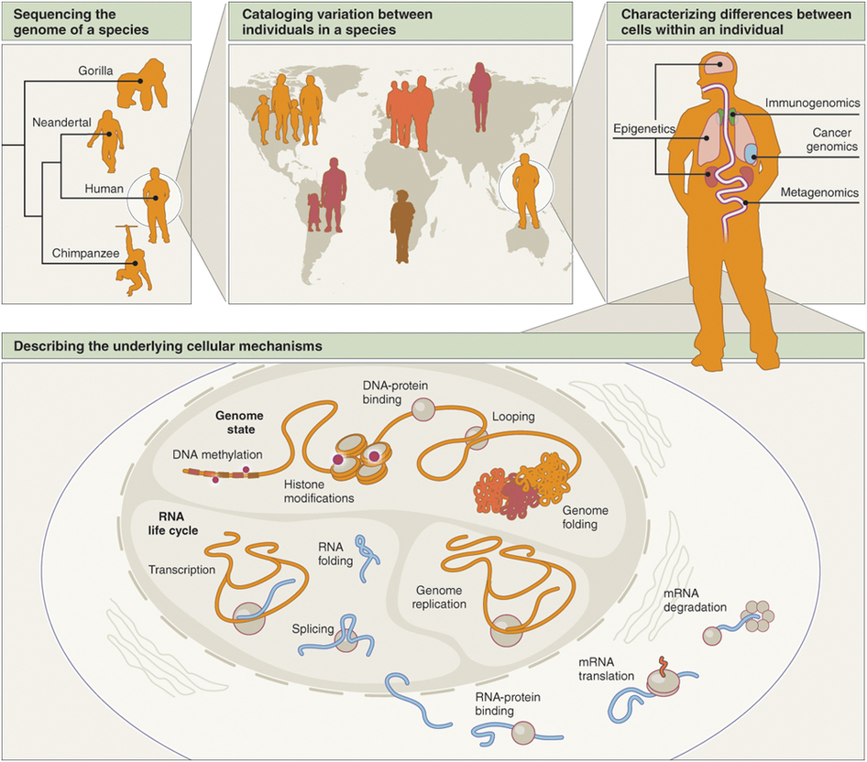
Sequencing is a foundational technology
Shendure & Aiden,
Nat. Biotech. 2012
Notes:
It isn’t just genetic variation discovery and transcriptomics

Slide 54
Sequencing is a foundational technology
Snippets of DNA or RNA are self-identifying (self-barcoded)
Use biochemical trick to select for DNA or RNA segments physically associated with “biological process” of interest”
Notes:
It isn’t just genetic variation discovery and transcriptomics

Slide 55
Sequencing is a foundational technology
Snippets of DNA or RNA are self-identifying (self-barcoded)
Notes:
It isn’t just genetic variation discovery and transcriptomics

Slide 56
Applications of NGS
Method | To determine…
DNA-Seq | A genome sequence
Targeted DNA-Seq | A subset of a genome (for example, an exome)
RNA-Seq | RNA (that is, the transcriptome)
Methyl-Seq | Sites of DNA methylation, genome-wide
Targeted methyl-Seq | DNA methylation in a subset of the genome
DNase-Seq, Sono-Seq | Active regulatory chromatin (nucleosome-depleted)
FAIRE-Seq (formaldehyde-assisted isolation of regulatory elements) | Active regulatory chromatin (nucleosome-depleted)
MAINE-Seq (MNase-assisted isolation of nucleosomes) | Histone-bound DNA (nucleosome positioning)
ChIP-Seq | Protein-DNA interactions (using chromatin immunoprecipitation)
RIP-Seq (RNA-binding protein immunoprecipitation) | Protein-RNA interactions
CLIP-Seq (cross-linking IP) | Protein-RNA interactions
Many applications
Human variation / human genetics
Cancer genetics
Clinical applications in human genetics and cancer genetics
Plant and animal breeding for agriculture
Sequencing new genomes
Metagenomics
Pathogen discovery
Pathogen evolution
Adapted from Shendure and Aiden, Nat. Biotech. 2012

Slide 57
More applications of NGS
Method | To determine…
HITS-CLIP (high-throughput sequencing of RNA isolated by cross-linking IP) | Protein-RNA interactions
FRT-Seq (on-flowcell reverse transcription) | Amplification-free, strand-specific transcriptome sequencing
NET-Seq (native elongating transcript) | Nascent transcription
Hi-C | Three-dimensional genome structure
Chia-PET | Long-range interactions mediated by a protein
Ribo-Seq | Ribosome-protected mRNA fragments (active translation)
TRAP (translating ribosome affinity purification) | Genetically targeted purification of polysomal mRNAs
PARS | Parallel analysis of RNA structure
Synthetic saturation mutagenesis | Functional consequences of genetic variation
Immuno-Seq | The B-cell and T-cell repertoires
Deep protein mutagenesis | Protein binding activity of synthetic peptide libraries or variants
PhIT-Seq (phenotypic interrogation via tag) | Relative fitness of cells containing disruptive insertions in diverse genes
Adapted from Shendure and Aiden, Nat. Biotech. 2012

Slide 58
Outline
Faculty introductions
“What is Bioinformatics?” and aims scope of this course
Next generation sequencing and bioinformatics
Review of biological molecules
Summary

Slide 59
https://en.wikipedia.org/wiki/Central_dogma_of_molecular_biology

Slide 60
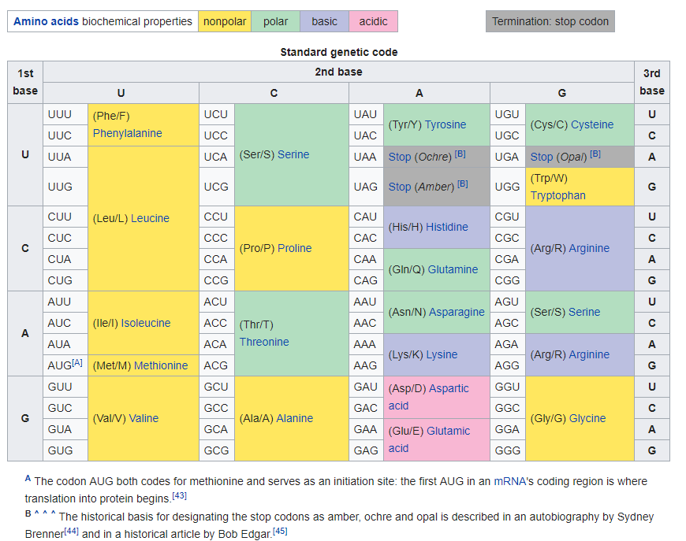
The “genetic code”:
how cells translate mRNAs to proteins
Each triplet, e.g. UUU (U = Uracil, which the RNA version of T = Thymine in DNA), is called a “codon”
You need to remember that AUG (ATG) encodes methionine and is the “start codon” -- every protein starts with methionine.
You also have to remember that 3 codons ( UAA, UAG, and UGA) do not code for an amino acid, but rather indicate the end of the protein. These are the “stop codons”. No need to memorize which ones they are.
https://en.wikipedia.org/wiki/Genetic_code

Slide 61
https://www.modernatx.com/pipeline/therapeutic-areas/mrna-therapeutic-areas-infectious-diseases
https://en.wikipedia.org/wiki/Moderna_COVID-19_vaccine
https://en.wikipedia.org/wiki/Pfizer%E2%80%93BioNTech_COVID-19_vaccine
Great summary of SARS-CoV-2 biology: https://www.nature.com/articles/d41586-021-02039-y
mRNA vaccines work by inserting new (modified) RNA into your cells (uracils are replaced by a modified version)
The vaccine mRNA encodes a slightly modified coronavirus spike protein so less likely bind to ACE2
https://en.wikipedia.org/wiki/Central_dogma_of_molecular_biology

Slide 62
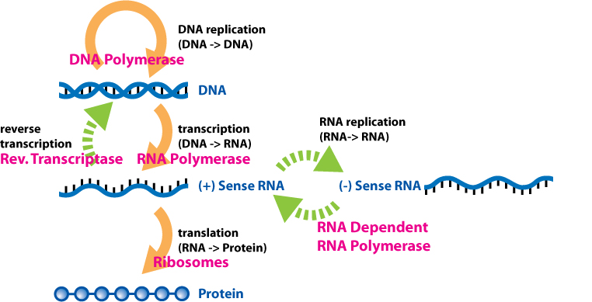
https://en.wikipedia.org/wiki/Central_dogma_of_molecular_biology

Slide 63
Biomolecules
DNA
RNA
Proteins (and peptides)
Lipids
“Small molecules”
Examples from neurotransmitters

Slide 64
Example small molecules (neurotransmitters)
Amino acids: glutamate, aspartate, D-serine, γ-aminobutyric acid (GABA), glycine
Gasotransmitters: nitric oxide (NO), carbon monoxide (CO), hydrogen sulfide (H2S)
Monoamines: dopamine (DA), norepinephrine (noradrenaline; NE, NA), epinephrine (adrenaline), histamine, serotonin (SER, 5-HT)
Trace amines: phenethylamine, N-methylphenethylamine, tyramine, 3-iodothyronamine, octopamine, tryptamine, etc.
Peptides: somatostatin, substance P, cocaine and amphetamine regulated transcript, opioid peptides
Purines: adenosine triphosphate (ATP), adenosine
Others: acetylcholine (ACh), anandamide
(https://en.wikipedia.org/wiki/Neurotransmitter)

Slide 65
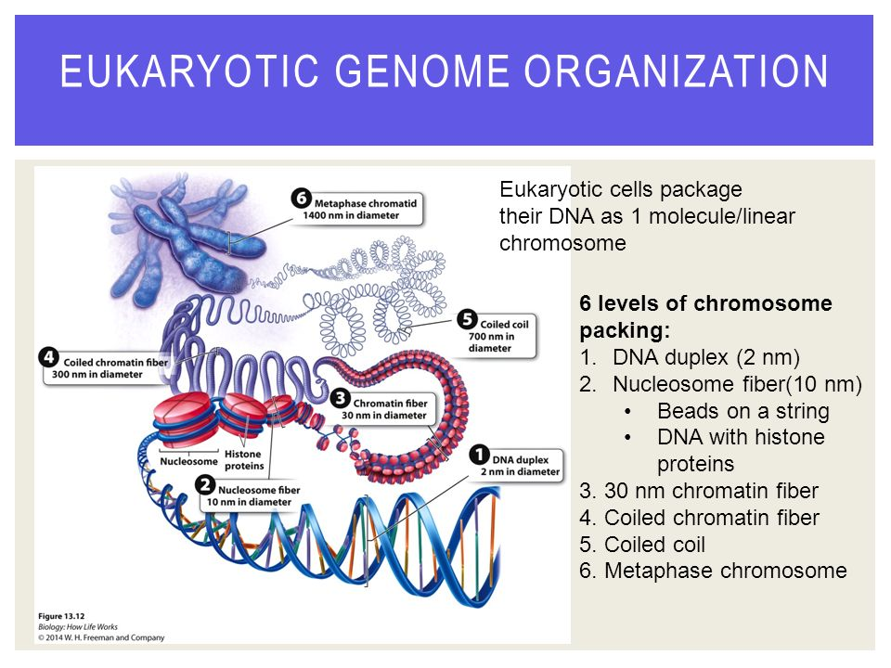

Slide 66
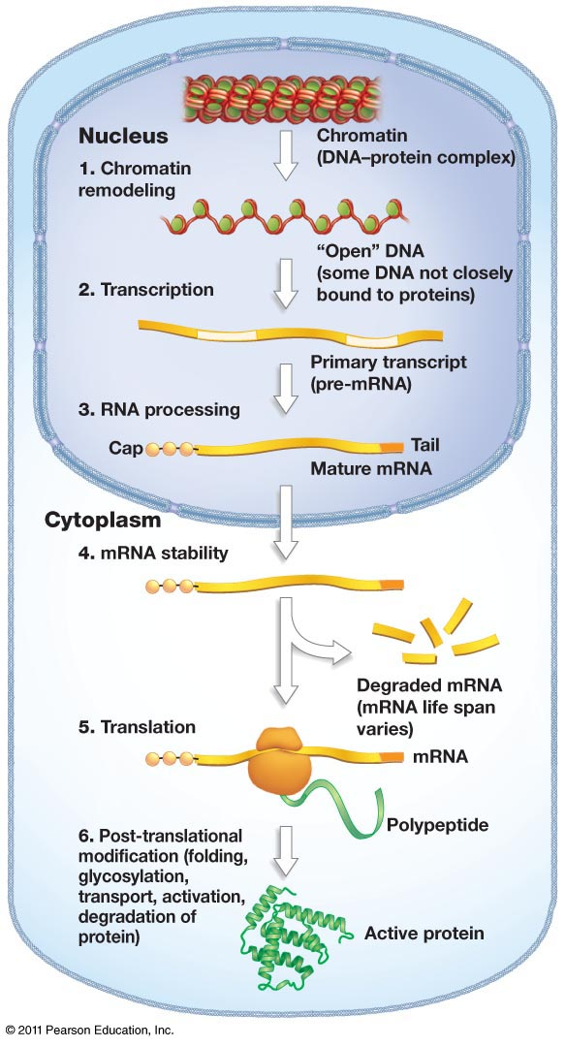
Interpreting the genetic program

Slide 67
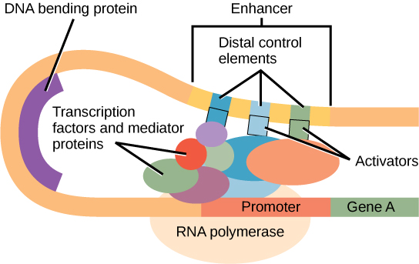
Interpreting the genetic program
https://courses.lumenlearning.com/wmopen-biology1/chapter/eukaryotic-gene-regulation/

Slide 68
Outline
Introductions, faculty and students
The professional histories of the faculty in their words
“What is Bioinformatics?” and aims scope of this course
Next generation sequencing and bioinformatics
Review of biological molecules
Summary

Slide 69
Summary
Introductions, faculty and students….
Students have varied backgrounds (to be expected)
Rozen will provide some students with supplementary reading on the basics of molecular cell biology
The professional histories of the faculty….
Variety of backgrounds – some from bench biology, some from computation
“What is Bioinformatics?” and aims scope of this course….
Several students pointed out that Nattestad’s video seemed to cast bioinformatics in a service role; faculty responded with approaches for establishing intellectual ownership of research questions
Review of biological molecules….
Source for more info (fairly high level) https://courses.lumenlearning.com/wmopen-biology1/
Next generation sequencing and bioinformatics….

Slide 70
The future of bioinformatics
will be driven by data

Slide 71
The future of bioinformatics
Data generation will continue to improve rapidly
Will generate more and new kinds of data
Example Oxford Nanopore: aiming for $1,000 human genome based on long reads
Better information on the small molecules and proteins in cells
More medical applications – first in severe genetic diseases and selection of therapies for cancer
Both already realities, but will expand
Personalized medicine based on genetics and biomarkers

Slide 72
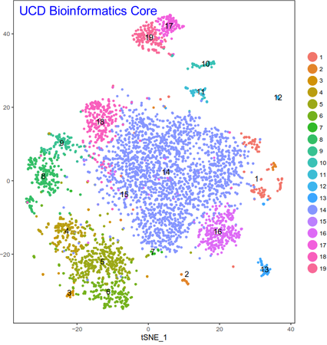
Hot technology: Single cell RNA-seq
Tissues contain multiple cell types
Even cancer tumours have multiple cell types in addition to the cancer cells
The RNA populations of individual cells can be measured, then the cells can be clustered based on their RNA population profiles
We can usually identify which cluster corresponds to which cell type based presence of RNAs from a few characteristic genes
http://dnatech.genomecenter.ucdavis.edu/single-cell-analyses/

Slide 73
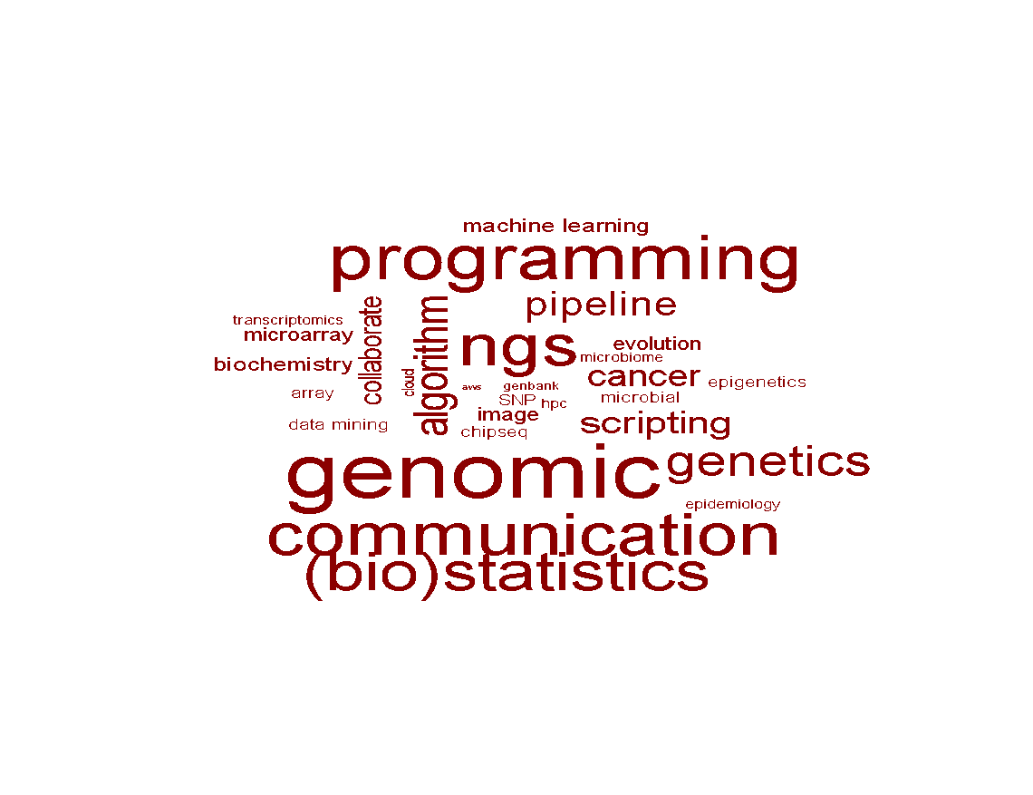
Genome bioinformatics is important 439 bioinformatics.org job ads
53%
48%
27%
67%
49%
44%
(Now quite old)

